Slide 1

Deep Learning

Slide 2
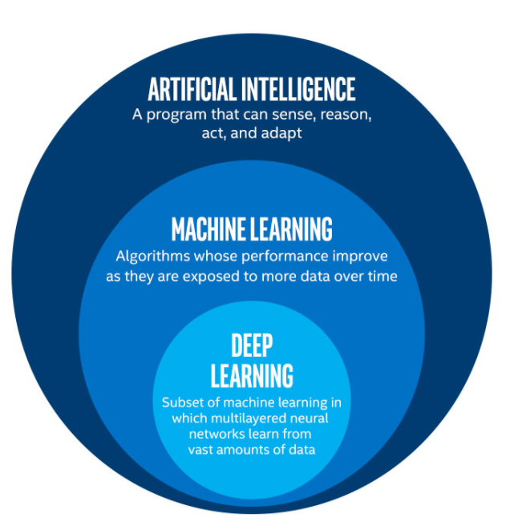
Deep Learning
Deep Learning is one of the method by which we can overcome the challange of feature extraction.
Example :
Face regonization system.
Object reconization technique
Handwritting recognization technique.
Discriminate different voices and even recognize person based on his/her voice
Natural Langauge Processing

Slide 3
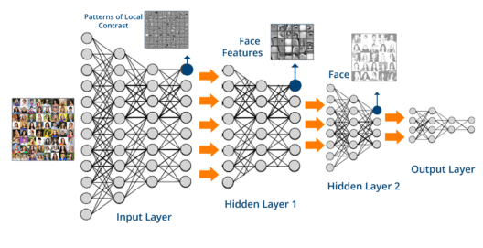
Deep Learning Example

Slide 4
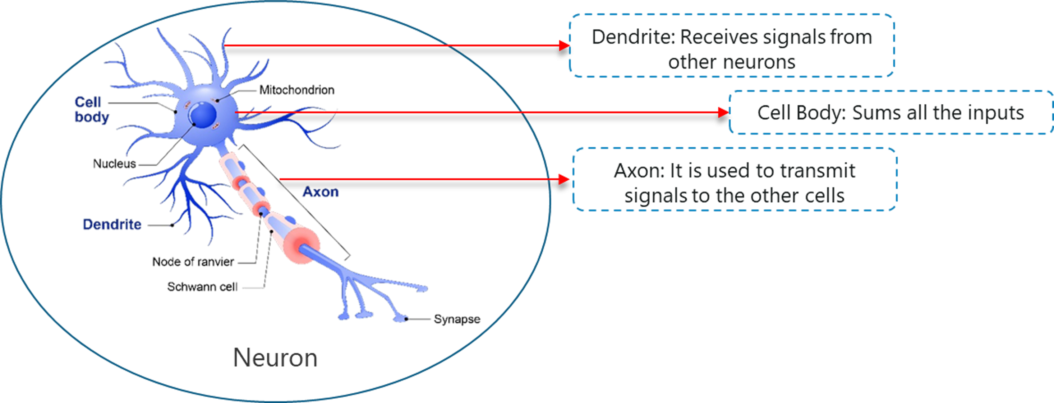
How Deep Learning Works ?
Deep Learning Studies basic unit of brain called as brain cell or neuron.
Inspired from nueron an artificial neuron or perceptron was developed.

Slide 5
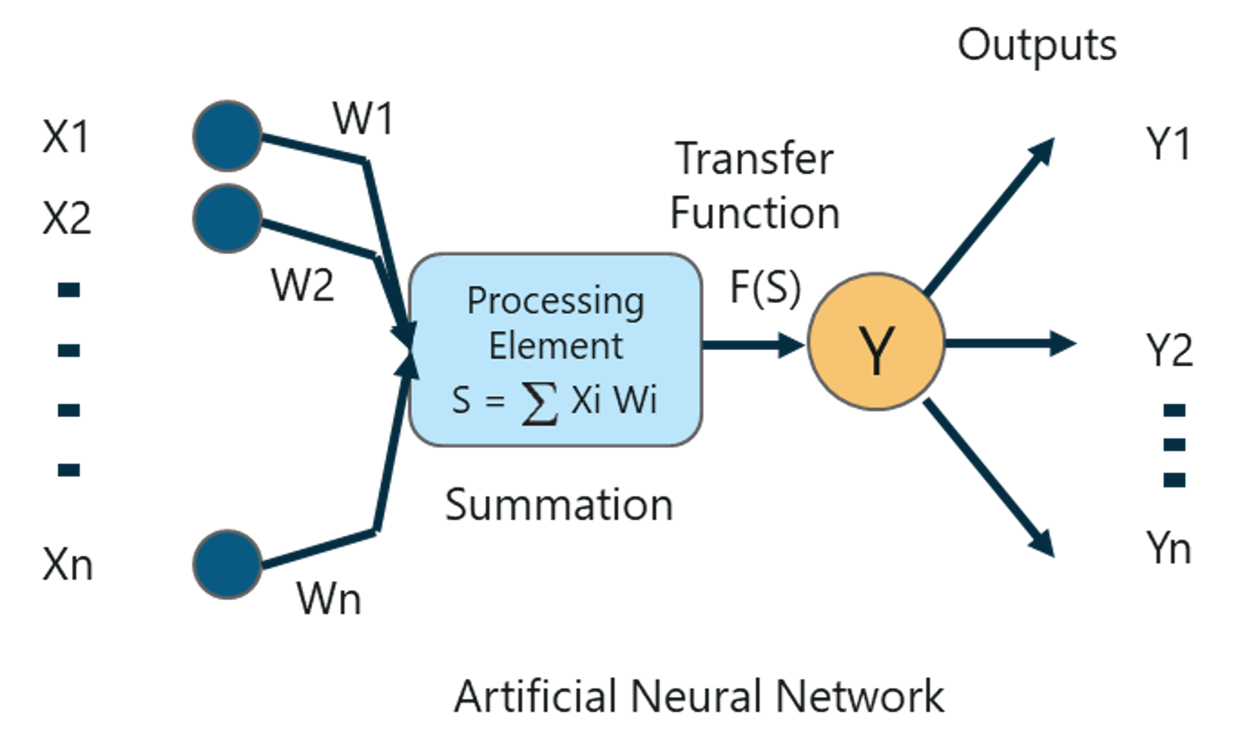
What Is A Perceptron?
What Is A Perceptron?
A Perceptron is a single layer neural network that is used to classify linear data or used for binary classification
Mainly used for supervised learning

Slide 6
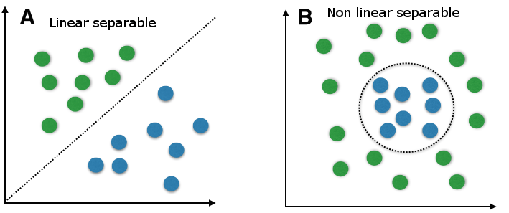
Why Multilayer Perceptron ?
A Perceptron is a single layer neural network that is used to classify linearly seperable data
A multilayer perceptron with back propogation is used to resolve this problem

Slide 7
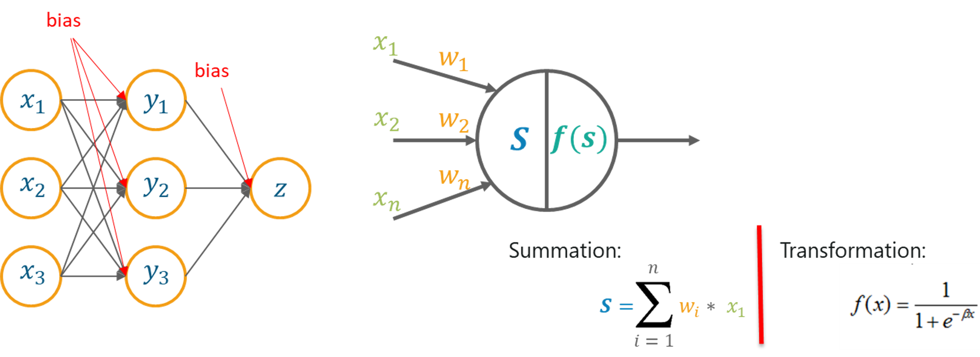
Multilayer Perceptron
A Multilayer perceptron is a classifier that contains one or more hidden layers.
It is considered as deep neural network.

Slide 8
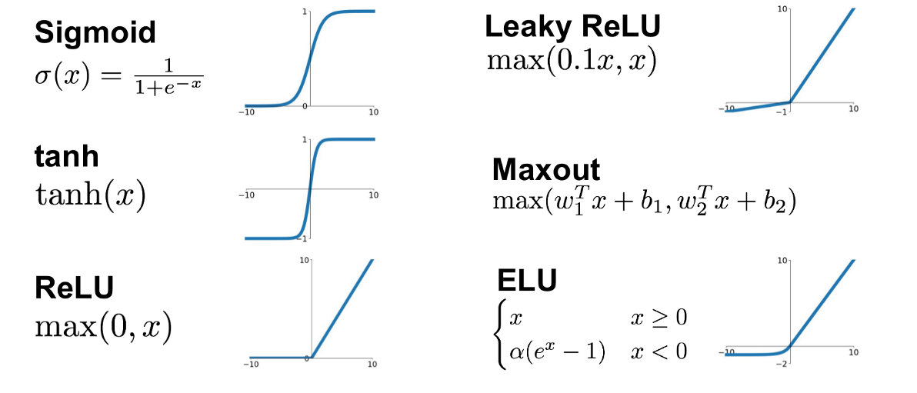
Activation Function

Slide 9
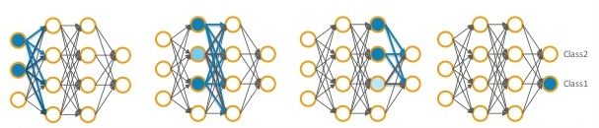
Feed Forward Network
One of the common deep learning alorihm is backpropogation which is used in feed forward network
This is used to update weights in such a way that most significant variable gets the maximum weight, thus reducing error while compting the output.
process of updating the weights and training the networks is known as Backpropagation.

Slide 10
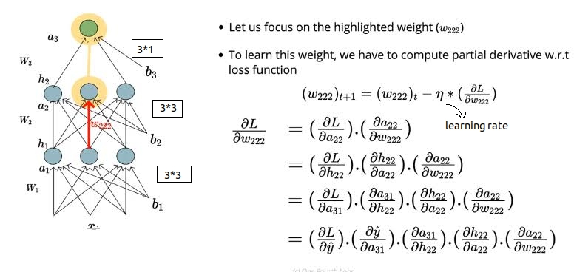
Backpropogation

Slide 11
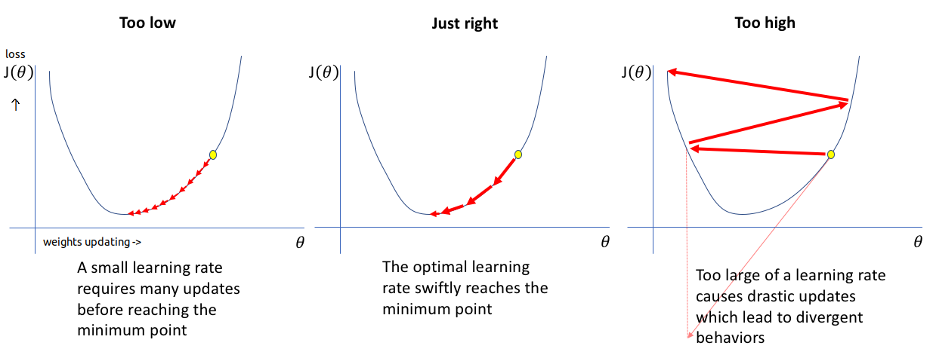
Why Learning rate important ?

Slide 12
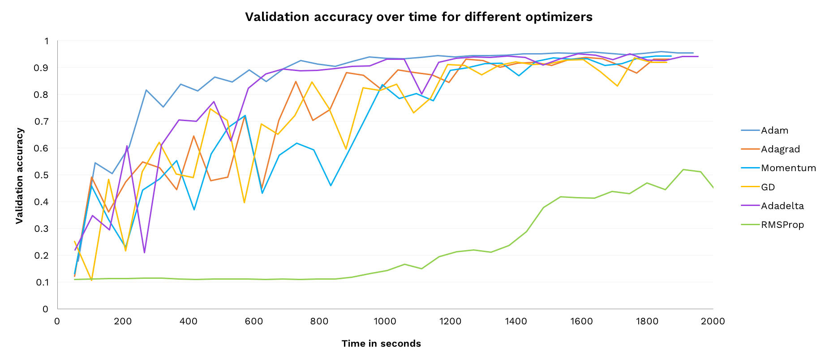
Optimizers

Slide 13
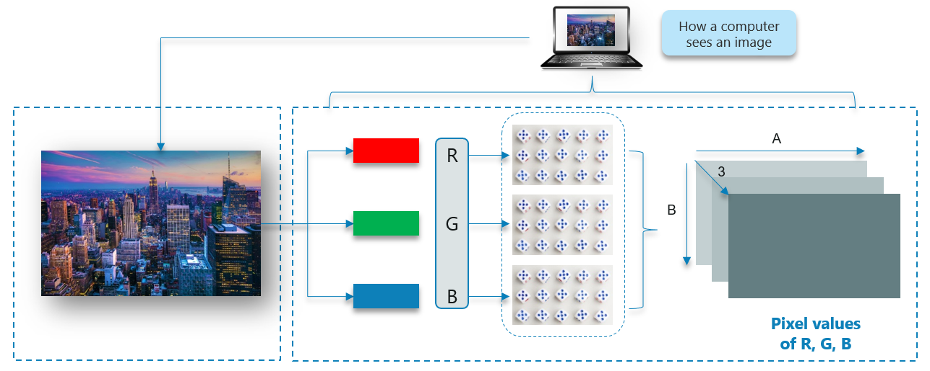
Convolutional Neural Network
Convolutional Neural Networks are designed to address image recognition systems and classification problems.

Slide 14
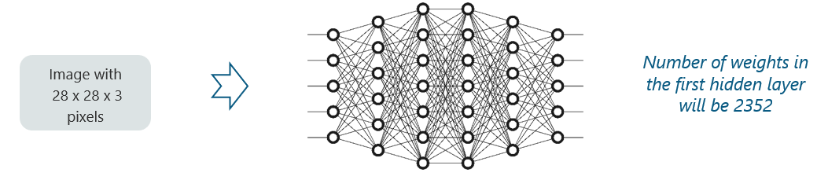
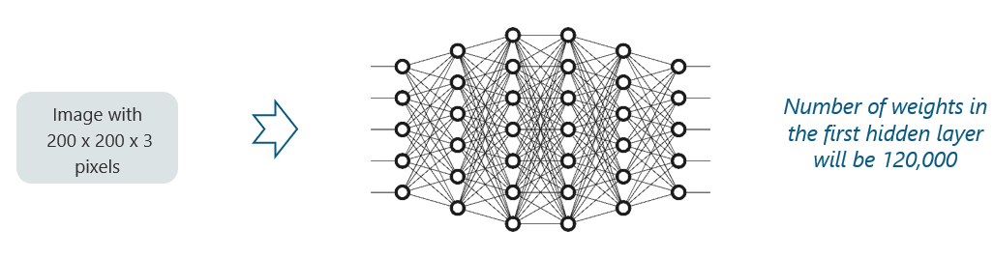
Why Convolutional Neural Network ?
We cannot make use of fully connected networks when it comes to Convolutional Neural Networks.

Slide 15
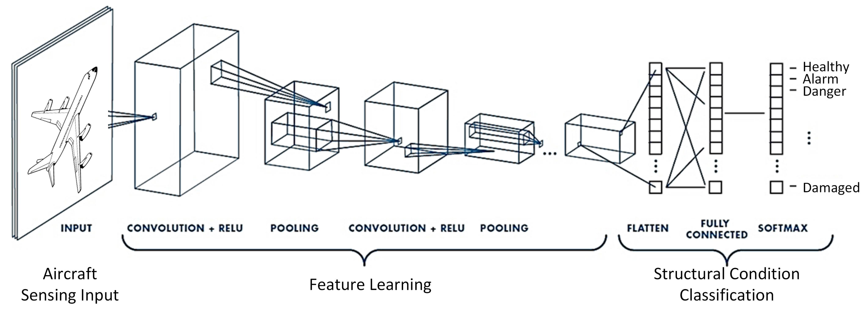
How CNN works ?

Slide 16
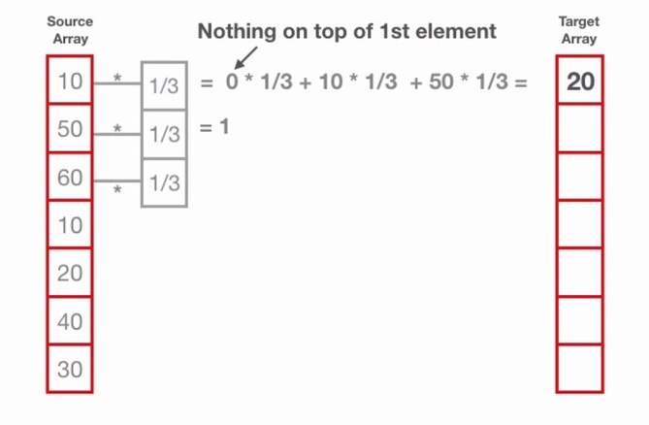
1D Convolution

Slide 17
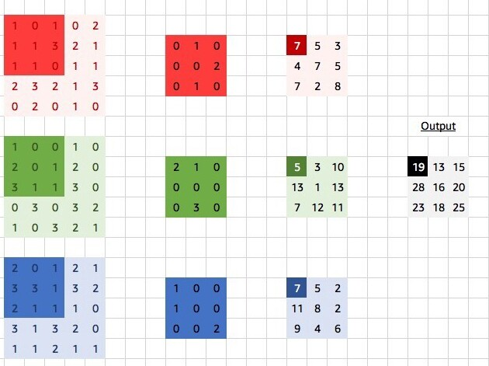
2D Convolution

Slide 18
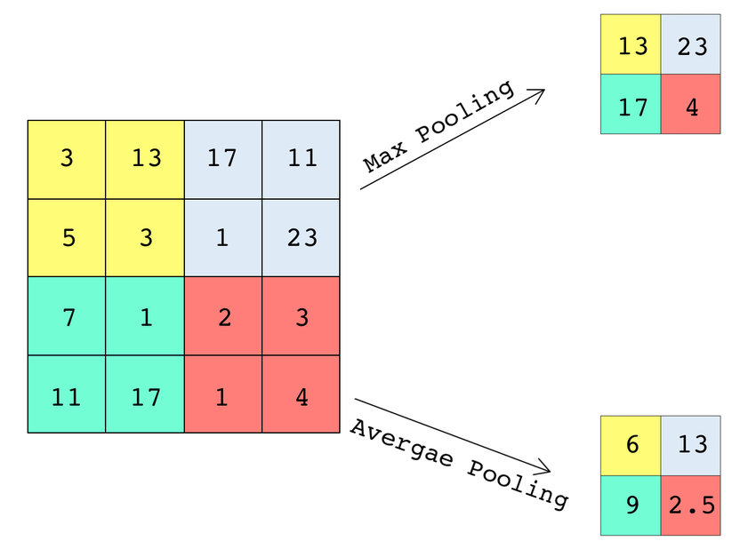
Pooling

Slide 19
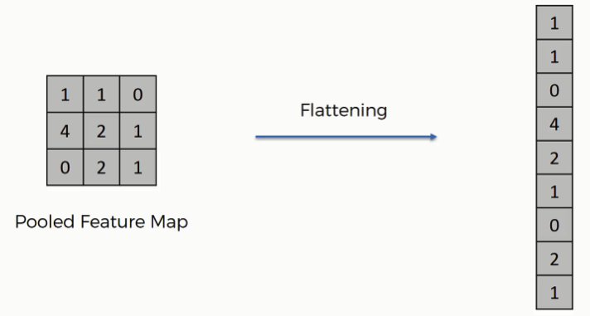
Flatten

Slide 20
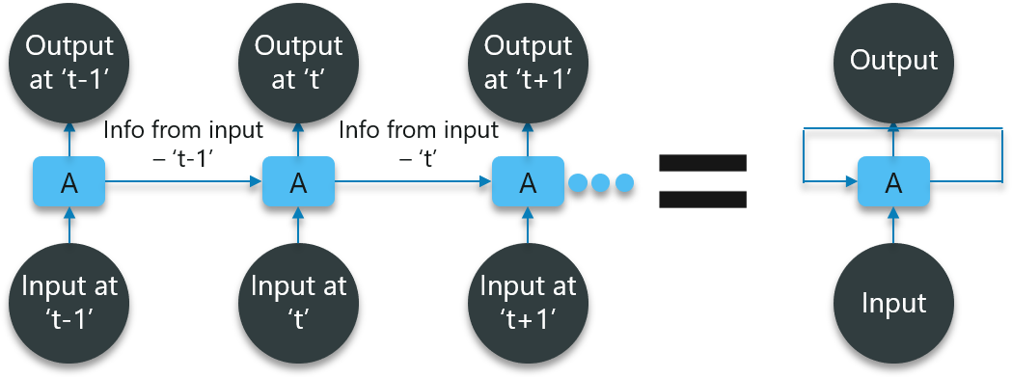
Recurrent Neural Network
Feed-forward networks cannot be used when predicting a word in a sentence as it will have no absolute relation with the previous set of words.
But, with Recurrent Neural Networks, this challenge can be overcome.

